Slide 1
MSDS670_X40_Data Visualization
Regis University
Week 6 Assignment
Ilse Severance

Slide 2
Overview
During this analysis, we aim to understand the relationship between gaming monetization behavior and indicators of mental health and social well being by evaluating monthly spending patterns alongside addiction risk levels, mood state, and social interaction metrics to determine whether high revenue engagement reflects healthy participation or signals elevated behavioral risk. The goal is to clarify whether rising spending represents genuine customer value or the beginnings of unhealthy dependency.

Slide 3
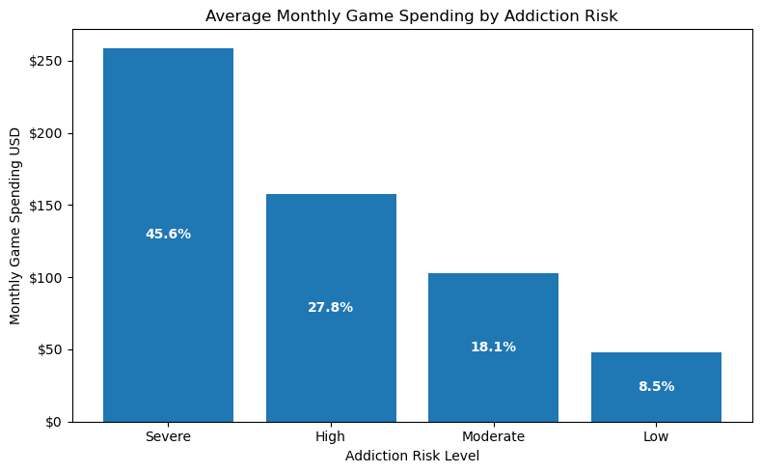
Average Monthly Game Spending by Addiction Risk
Average monthly spending increases noticeably as addiction‑risk levels rise, with high and severe risk users spending significantly more than low risk users.
The pattern shows that the financial spending is strongly connected to behavioral intensity.
From a business perspective, this means a substantial revenue may be coming from users who show elevated risk levels.

Slide 4
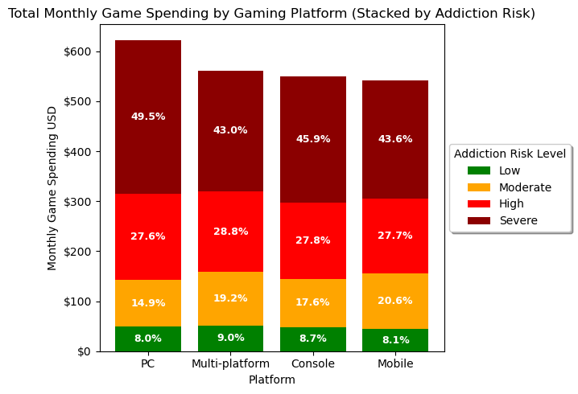
Monthly Game Spending by Gaming Platform
Platforms like PC and console show the highest concentration of severe risk users, indicating stronger ties between platform and elevated spending risk.
Mobile and multi‑platform players also show increasing risk levels, but the rise is less abrupt compared to PC, suggesting platform may influence vulnerability differently.
These differences imply that certain platforms and monetization may contribute to higher behavioral risk exposure.

Slide 5
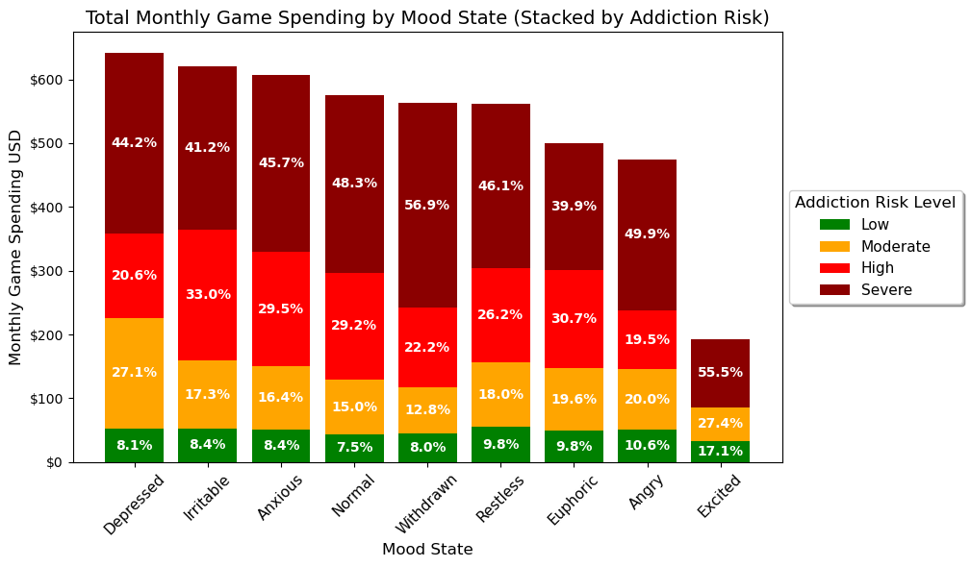
Monthly Game Spending by Mood State
Negative or unstable mood states are linked to higher spending, with high, and severe risk users spending the most.
Spending patterns suggest some users may be using gaming as emotional regulation, not just entertainment.
This raises ethical concerns for businesses, as monetization may disproportionately affect emotionally vulnerable users.

Slide 6
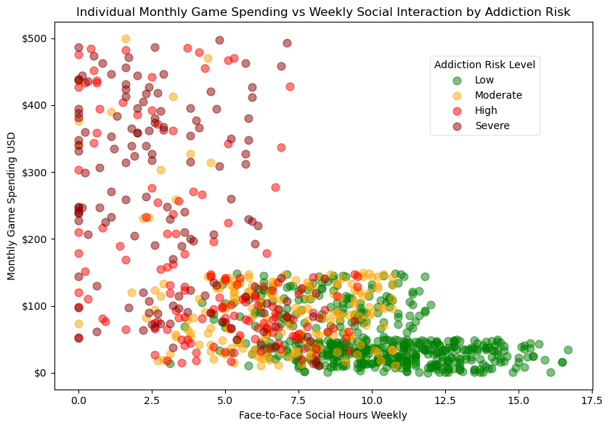
Monthly Game Spending vs Weekly Social Interaction
The data shows users that increase their monthly game spending, tend to have fewer in-person social hours.
The clustering of high spenders at low social interaction levels suggests a possible behavioral effect.
If this pattern drives growth, it could raise concerns about users balance over time.

Slide 7
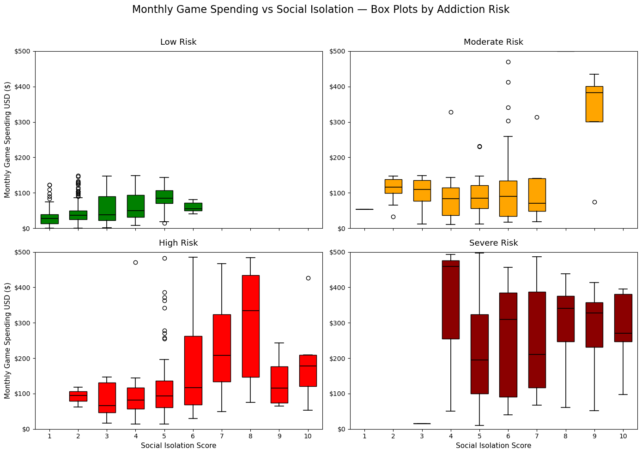
Monthly Game Spending vs Social Isolation
The box plots show that high and severe risk users who spend the most also tend to have higher social isolation scores, creating a clear cluster of high spend and high isolation.
This pattern is much weaker among low risk users, who stay mostly in the low‑spend, low‑isolation range.
Because heavy spending is concentrated among more isolated users, relying on this segment for revenue could raise concerns over time.

Slide 8
Conclusions
Overall, the analysis shows that higher gaming spending consistently aligns with higher behavioral risk, with the biggest spenders frequently appearing in categories tied to elevated addiction risk, negative mood states, reduced in‑person social interaction, and higher social isolation scores. Platforms also play a role, as PC and console show the strongest concentration of severe risk users. Emotional factors further contribute, with users in negative moods spending more, indicating that spending may sometimes function as a coping mechanism rather than entertainment. Across these patterns, revenue appears disproportionately driven by vulnerable users, raising important ethical concerns.

